Slide 1
Coursera Capstone Project
Battle of the Neighbourhoods – Week 2

Slide 2
The Business Problem
BrightMindsDS is a new tech company that specialises in Machine Learning and Big Data.
They are currently looking for a new office space as they have expanded their clientele.
They are hoping to move from Kent to London
They wants to find a suitable office space to encourage growth, innovation and creativity.
The CEO believes that his employees' health and wellbeing will be a main driver towards the company's success.
"Although success can bring happiness, to create great work, the employees’ health, wellbeing and happiness is the most important factor." (1)
In order to obtain an ideal location for the new office space, the London area is explored through clustering and segmentation based on London Post code data and fulfilment of the requirements.
https://inside.6q.io/employee-health-wellbeing-matters/

Slide 3
Requirements
The CEO wants to create a nice atmosphere for his new employees. He believes that his employees' health and wellbeing will be a main driver towards the company's success. When looking at possible locations for the new office, things like:
Can it be accessed via local transport?
Are there any gyms nearby?
Is there a nice park/open space near by?
Are there good coffee shops nearby for lunch?
Are there good bars/nightclubs to socialise in after work?
will be considered. A minimum of 2 of these requirements is ideal for a new office location.

Slide 4
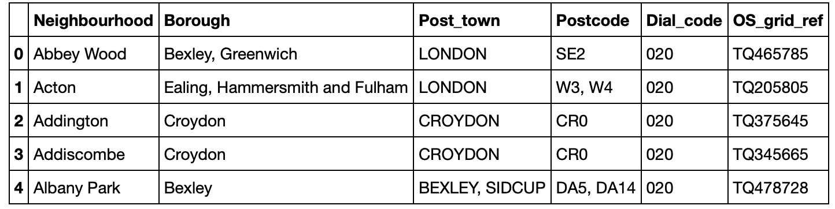
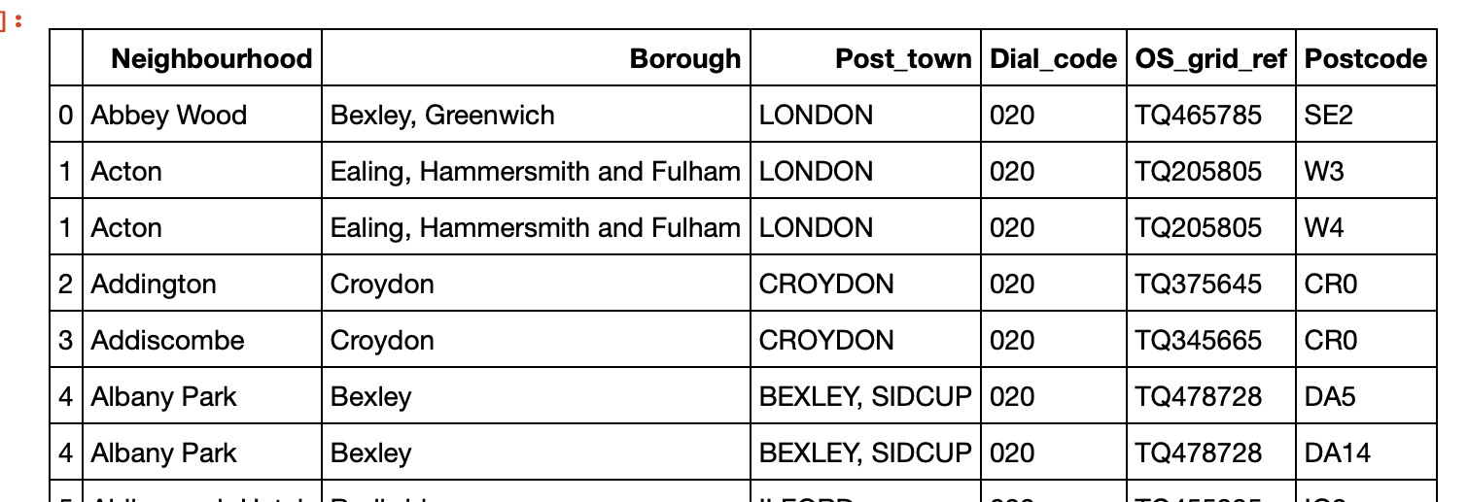
Data
Breaking up neighbourhood’s that have more than 1 postcode
Using the Beautiful Soup library I am going to scrape London neighbourhood data from Wikipedia.
After implementing some manipulations, I will end up with a pandas data frame.
<https://en.wikipedia.org/wiki/List_of_areas_of_London >
Feature selection:
Neighbourhood
Borough
Post_town
Postcode

Slide 5
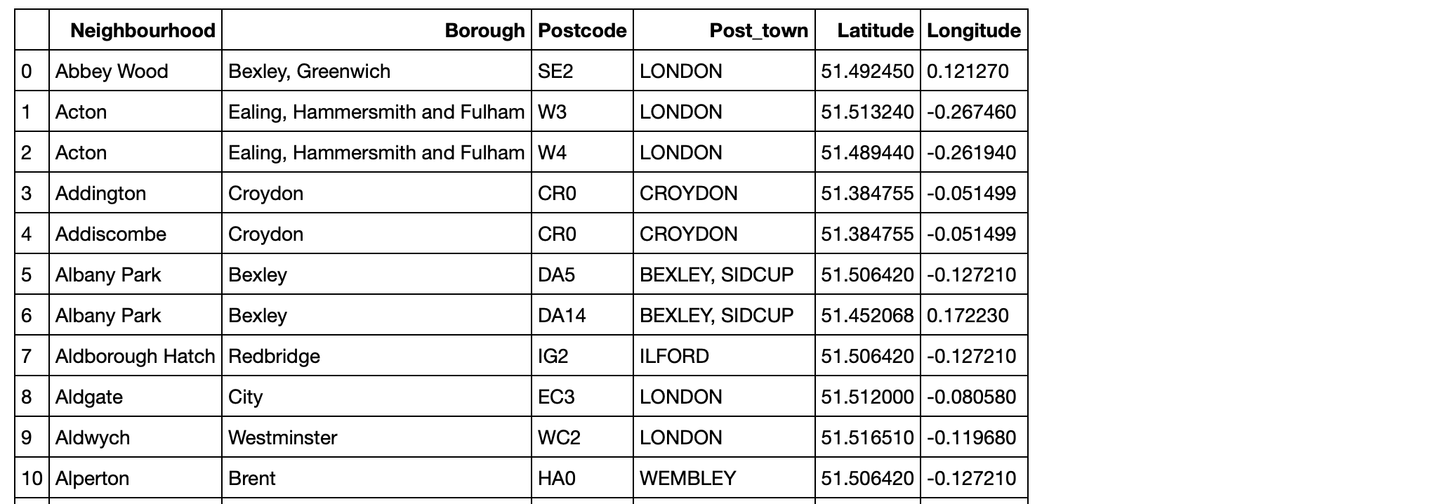
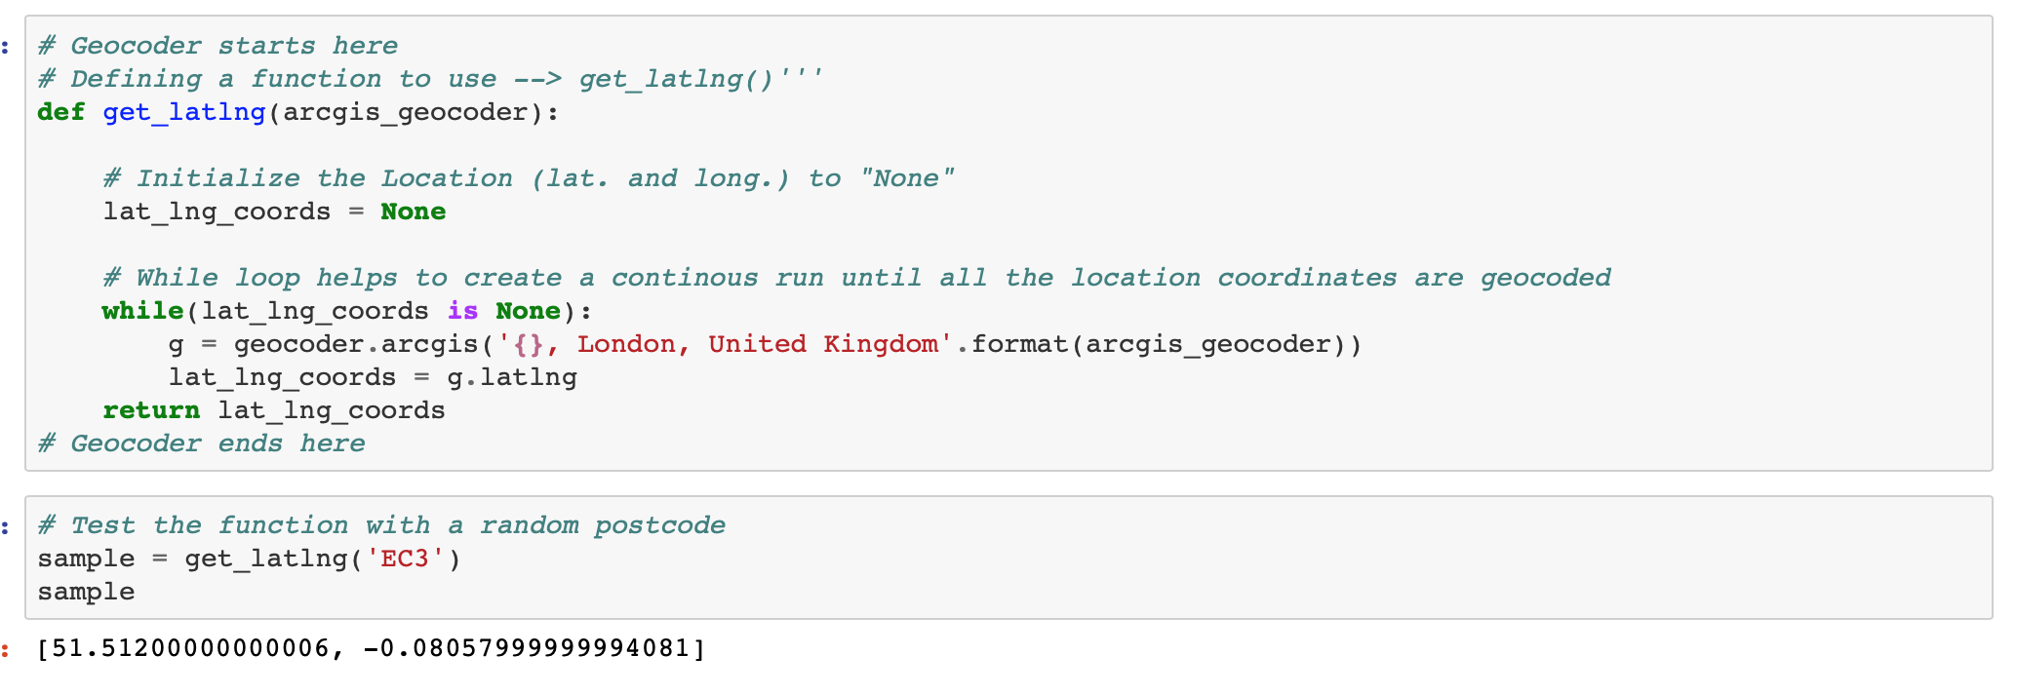
Geocoder package
To be able to visualize the data, coordinates of each neighbourhood need to be obtained.
This will be done by using the Geocoder package.

Slide 6
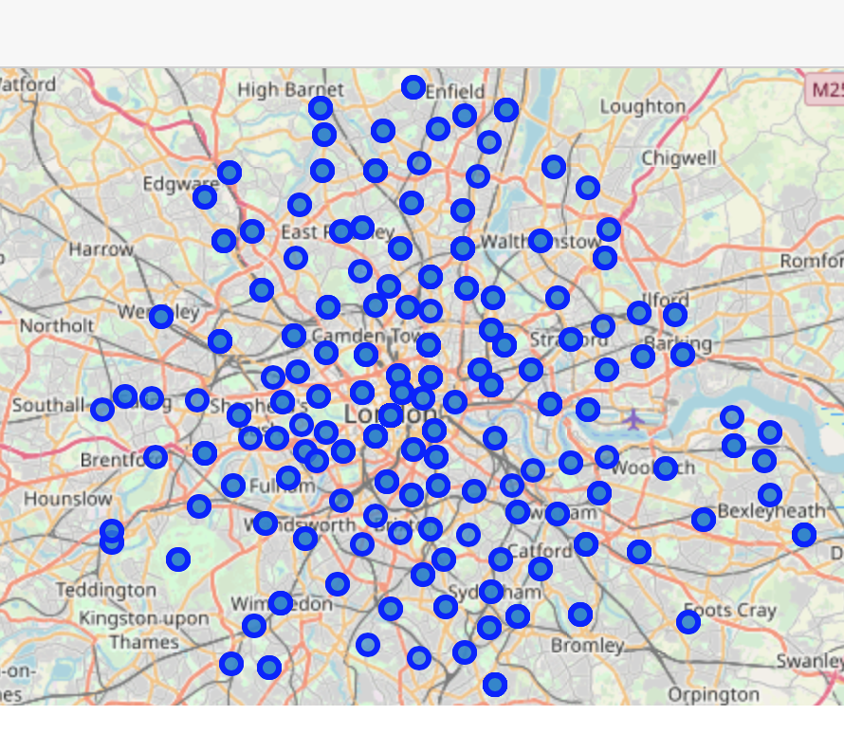
Visualisation using Folium
Using the folium visualization library alongside the data obtained from Wikipedia and Geocoder, I was able to superimpose all neighbourhoods onto an interactive map of London. As can be seen this is a very large dataset.
Due to the limitations of the free Foursquare API the size of this dataset will need to be decreased. I am going to focus on East London only.

Slide 7
East London? Why? How?
Where the East London Tech City is located.
Boroughs with the Post Code starting with E or EC.
"Some ask why they should set up there. I say the cluster is where your business is most likely to succeed. Your partners clients, investors will be there. You’ll be able to hire people. You’ll come up with great ideas.”
# Strips whitespaces before postcode
EL.Postcode = EL.Postcode.str.strip()
# New dataframe for East London postcodes
east_london = EL[EL['Postcode'].str.contains(('E'))].reset_index(drop=True)
# Only select rows where post town is LONDON
london_towns = clean_df[clean_df['Post_town'].str.contains('LONDON')]
https://www.mbymontcalm.co.uk/blog/all-you-need-to-know-about-east-london-tech-city/

Slide 8
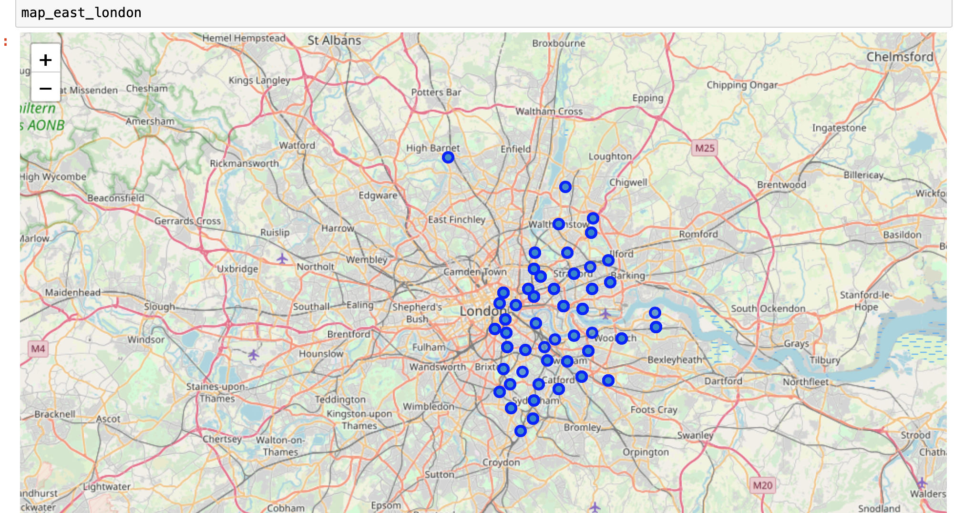
East London – Results
Data set is now much smaller so can be used with Foursquare API.

Slide 9
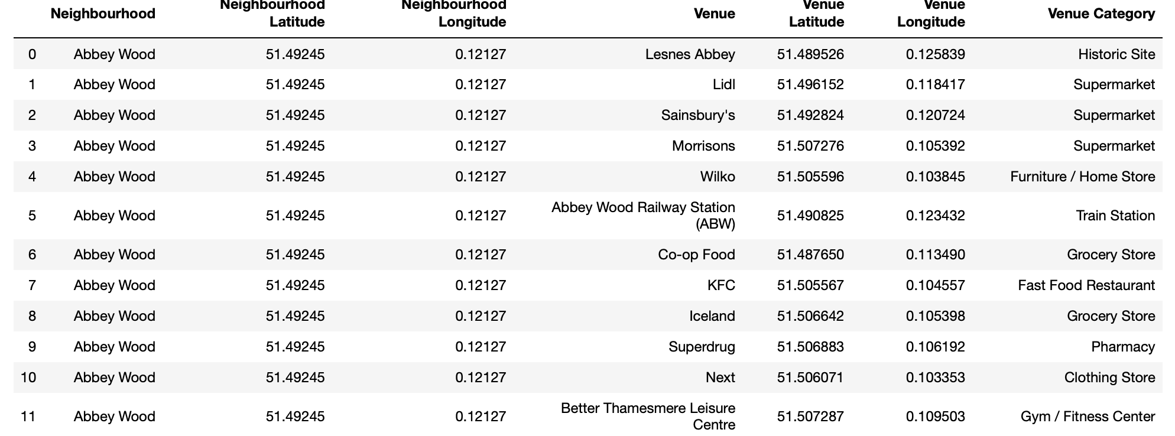
What is Foursquare?
Foursquare is a social location service that allows users to explore the world around them.
The Foursquare API allows application developers to interact with the Foursquare platform.
The API itself is a RESTful set of addresses to which you can send requests, so there's really nothing to download onto your server.
Using Foursquare I can obtain information about the venues local to each neighbourhood:

Slide 10
Methodology

Slide 11
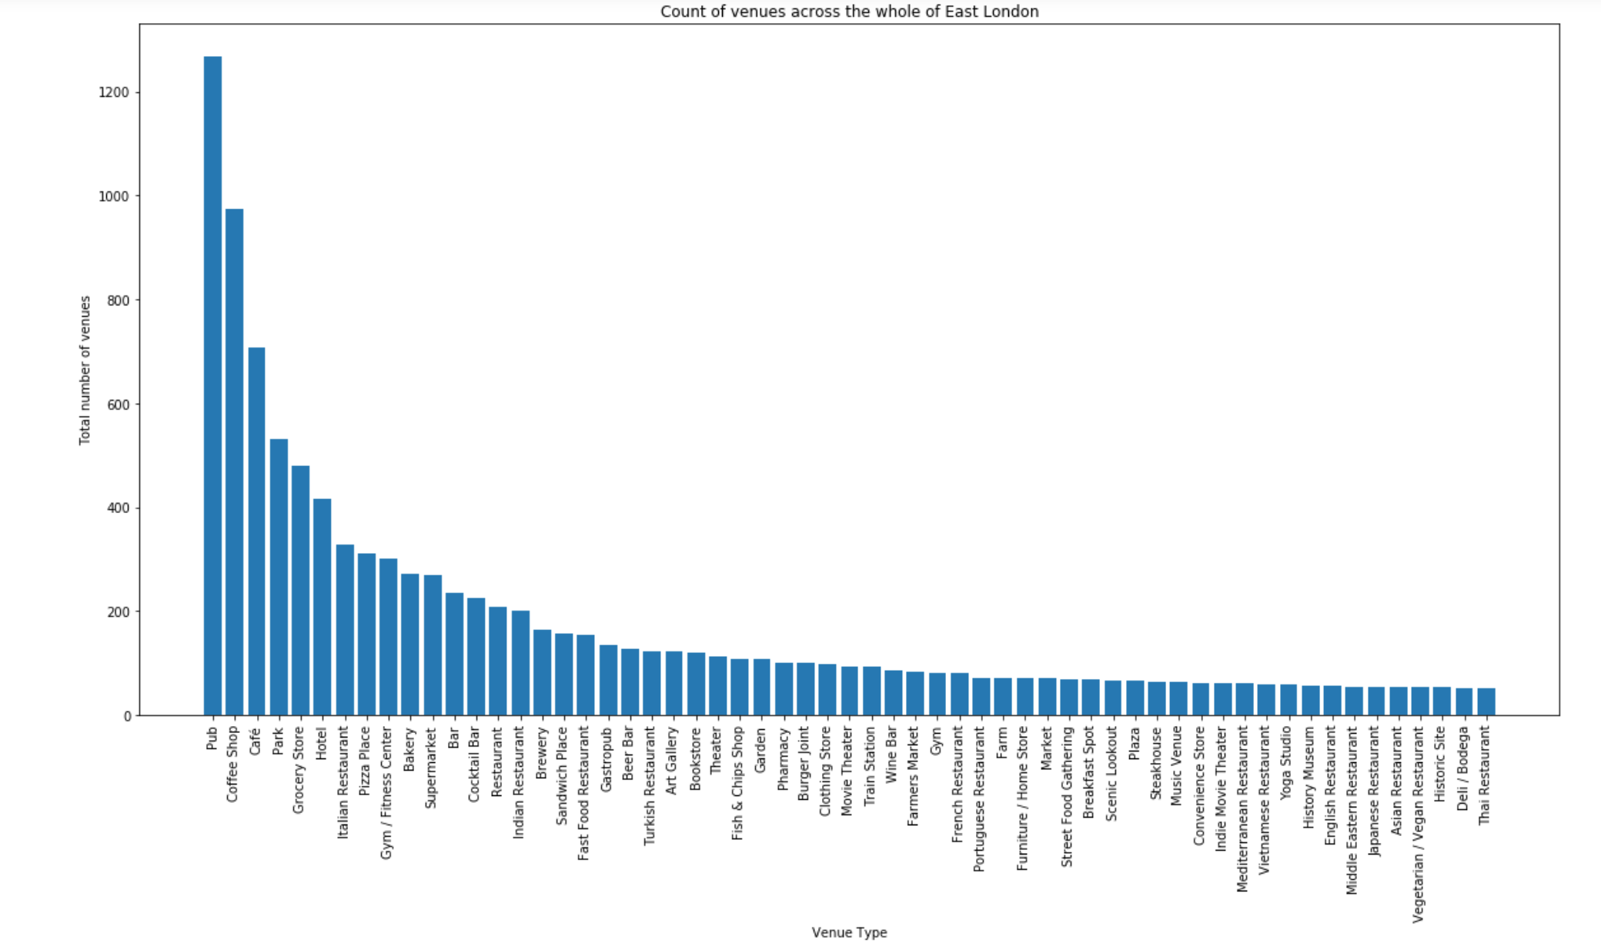
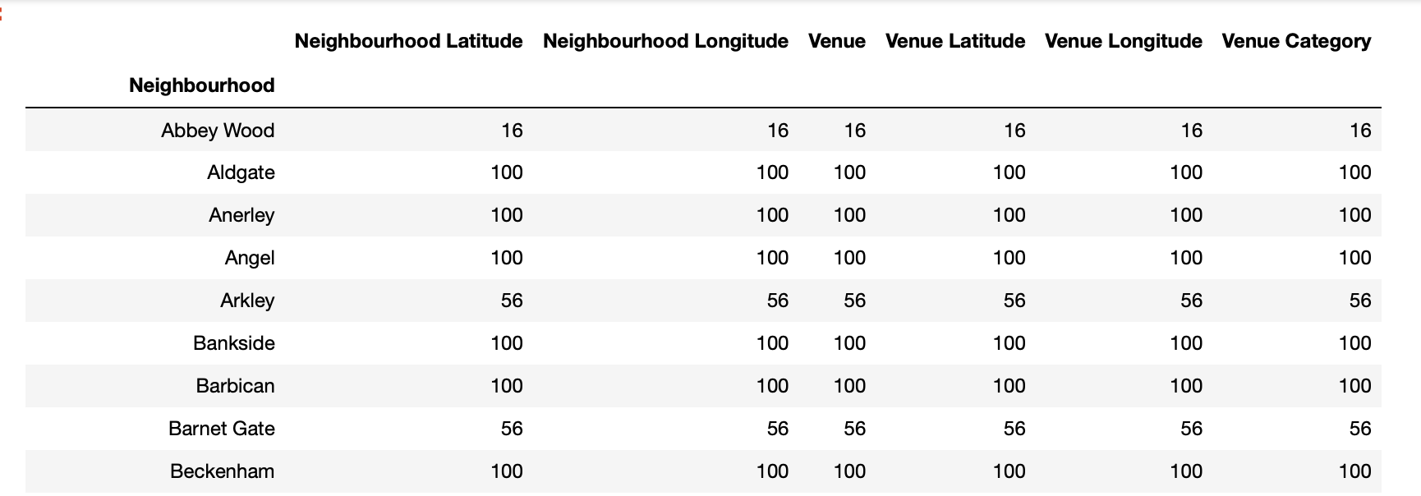
I started by breaking the data down by neighbourhoods; looking at how many venues are in each location. This shows which areas of London may have more going on compared to quieter settings with less to do.
Looking back at the requirements set out by BrightMindsDS I can assess whether they are realistic, fortunately, all venues fitting the criteria listed by the company had a high total count across East London.
Creating a bar chat, this made it easier to visualise.

Slide 12
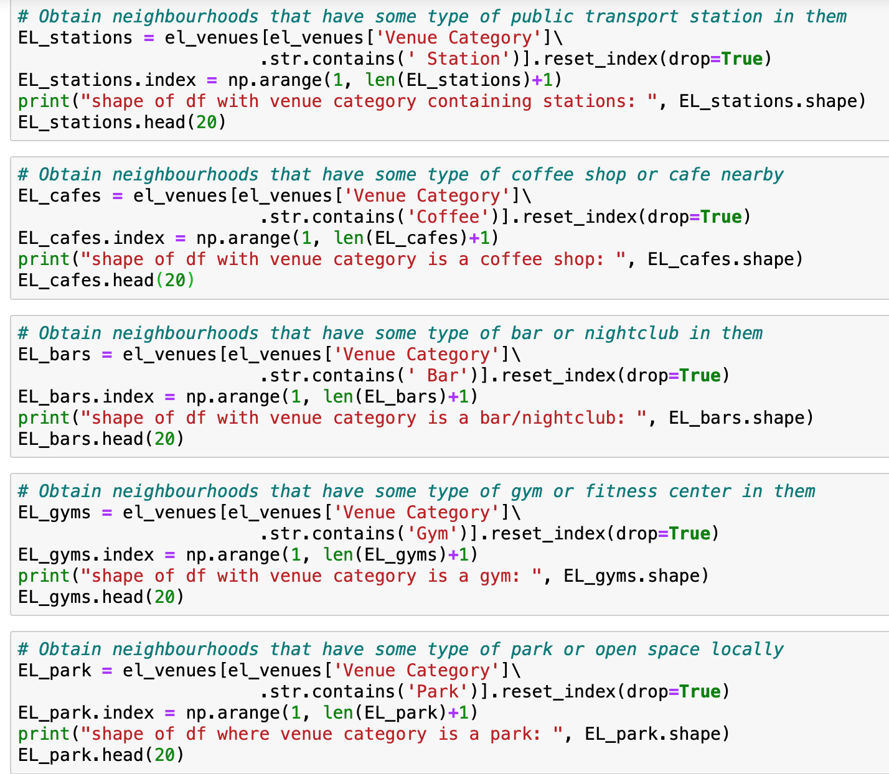
Further Cleaning
This was another example of data cleaning. I realised all data related to venues like museums, stadiums or zoos etc wasn't relevant and could negatively influence the machine learning model. This way I could only look at neighbourhoods that met a least 1 of the requirements. Saving time and resources spent looking at locations that couldn't satisfy the company.
I sorted the list alphabetically by neighbourhood. Although very simple, doing this helped obtain a clearer picture of what venues can be found in each neighbourhood. I broke this down further by looking at a count of unique venue categories per Neighbourhood. I visualised this using stacked bar graph.

Slide 13
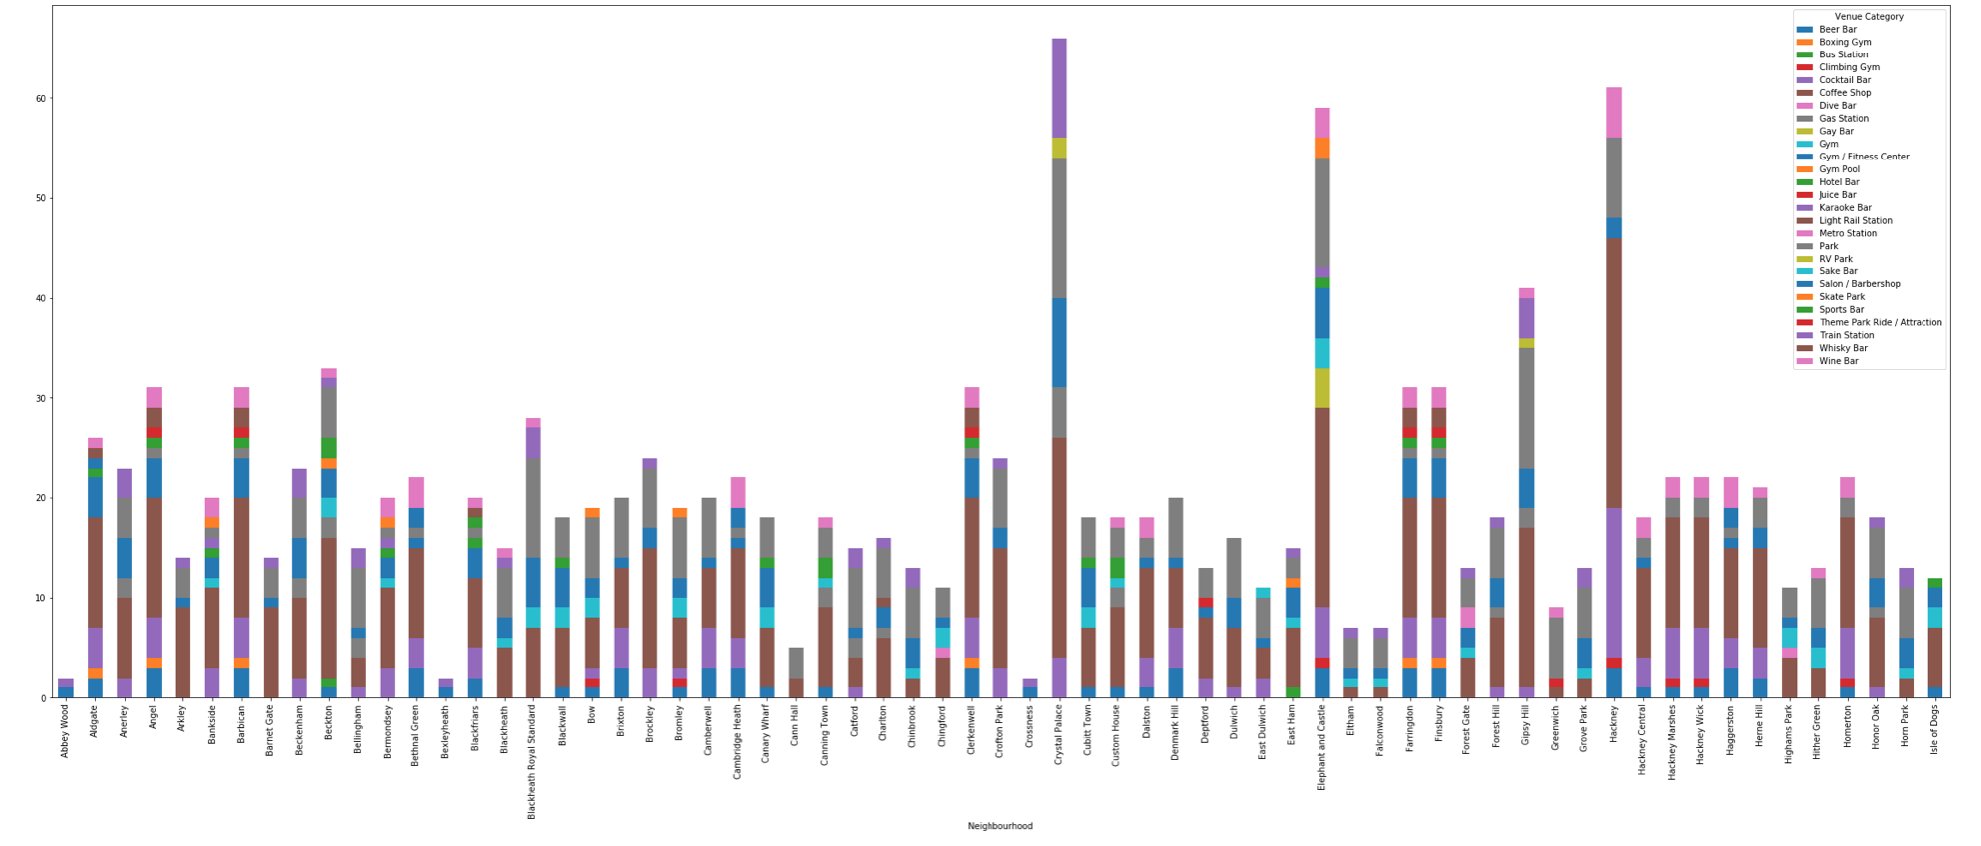
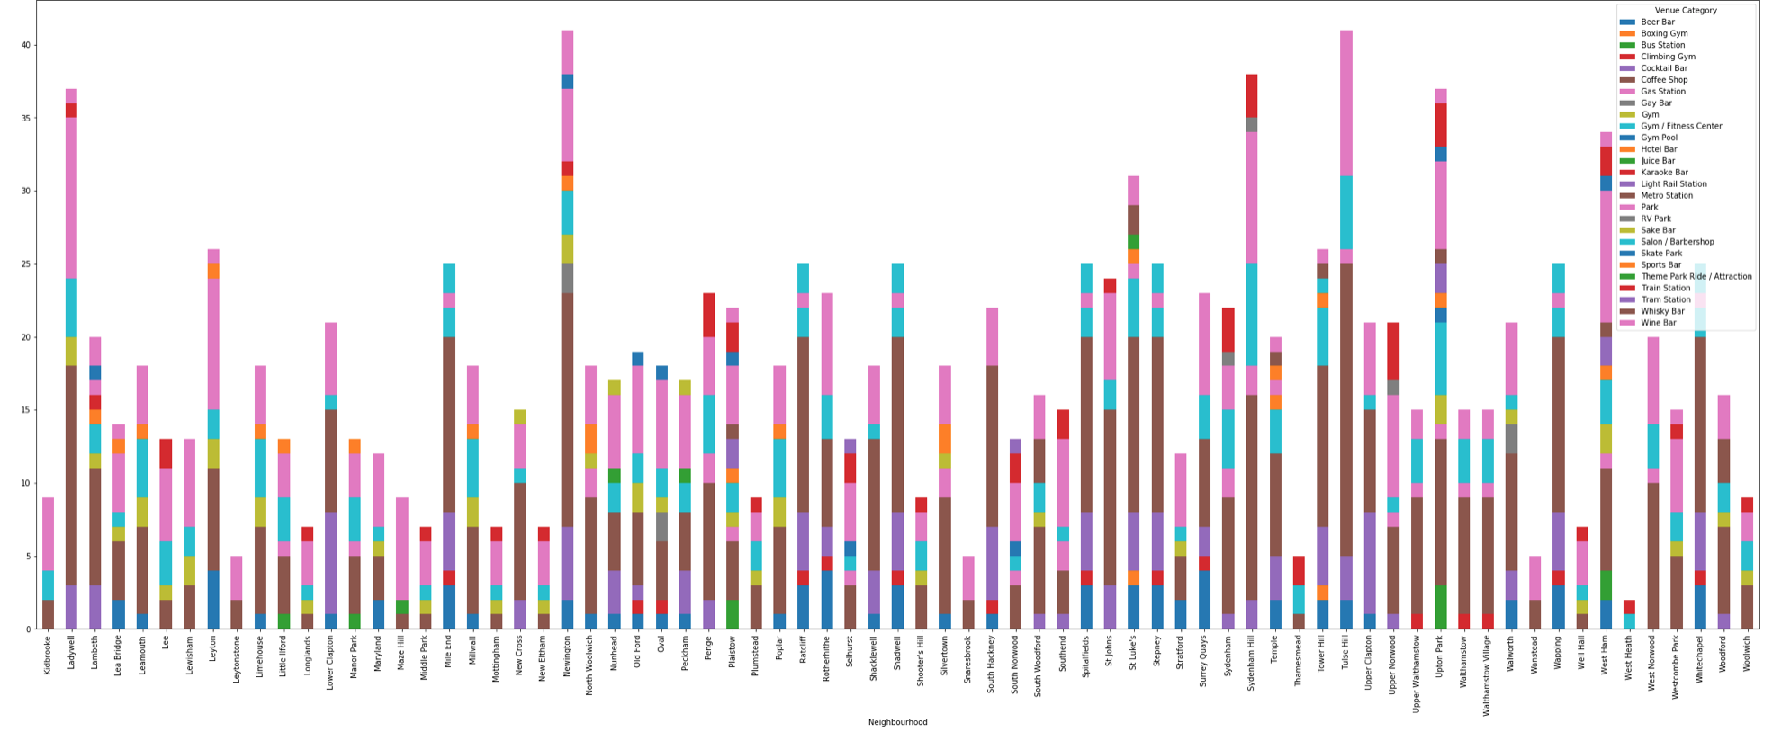
Stacked bar charts are a great way to visualise trends and outliers. In this occasion, you can see Gay Bars do not appear very often, Elephant and Castle seems to have the largest count. Using the coloured keys it can be a nice way to pick out important information quickly. Due to the wide variety of venues it can be used for multiple purposes too.

Slide 14
An Added Extra
Using the Haversine function I was able to calculate the distance between each venue and the respective neighbourhood.
If stuck between a choice of locations or unsure if a nightclub would be better than a pub, using distance can make the decision easier for BrightMindsDS. The more information you can give to a client the better the relationship will be.

Slide 15
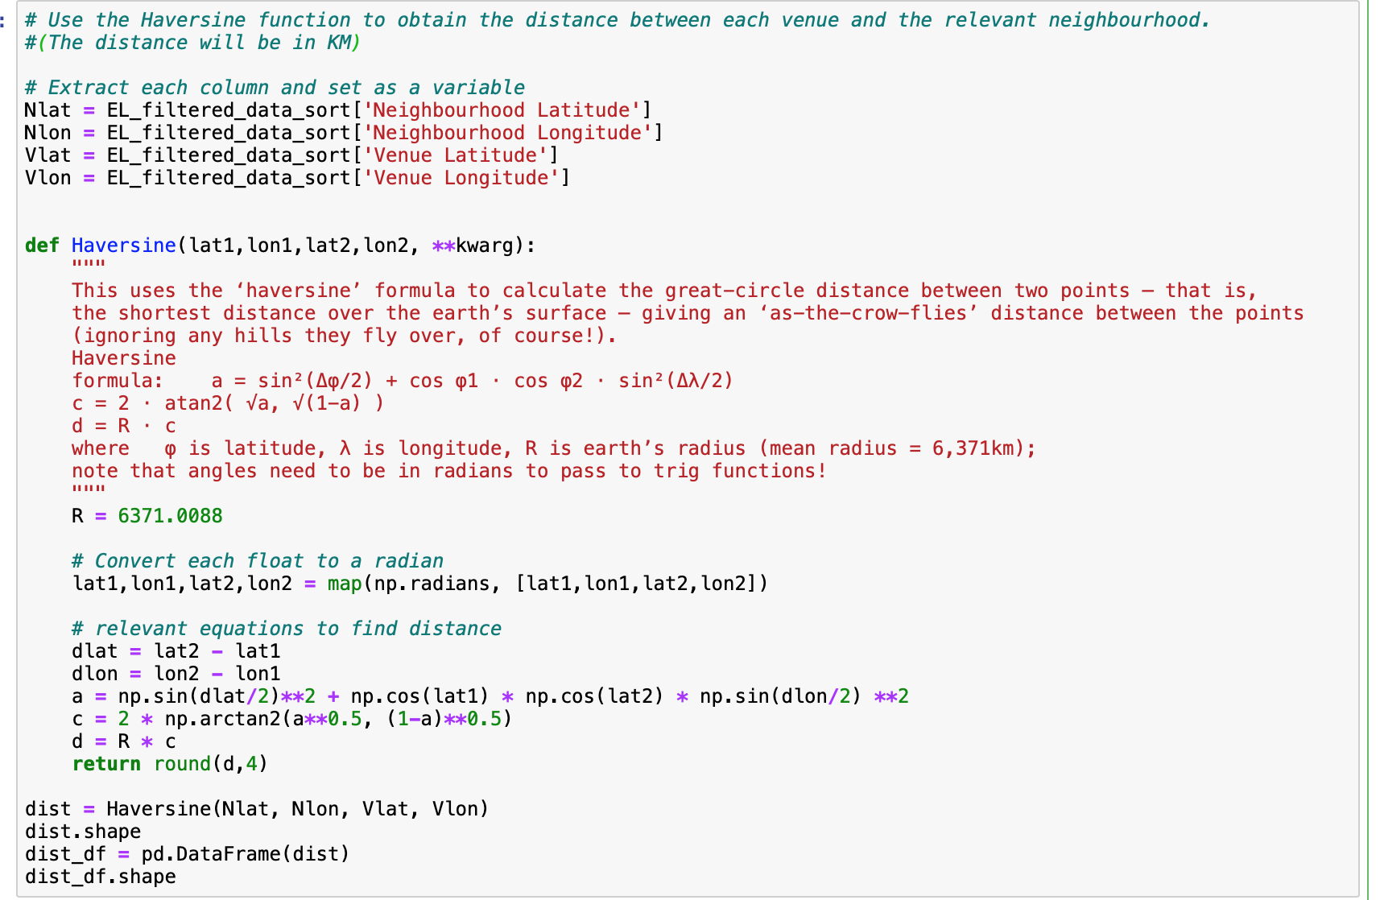
An Added Extra – The Haversine Function
The haversine formula is an equation important in navigation, giving great-circle distances between two points on a sphere from their longitudes and latitudes. It is a special case of a more general formula in spherical trigonometry, the law of haversines, relating the sides and angles of spherical "triangles". https://rosettacode.org/wiki/Haversine_formula

Slide 16
One-hot encoding
One-hot encoding assigns common variables their own vector and gives them a value of 1 or 0. The length of these vectors is equal to the number of classes or categories the model is expected to classify. As a result the more variables in a column will now correspond with how often the variable appears in the vector.
Using my data as an example, each row is a vector. It will loop through the data set and assign a 1 to that column if the venue is associated with the respective neighbourhood or a 0 if not. Now all data is numerical, it can be inserted into a Machine Learning model. It will provide further insights into what is on offer in each neighbourhood

Slide 17
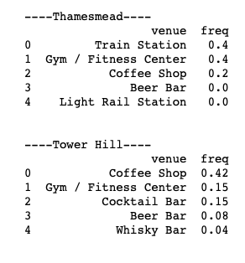
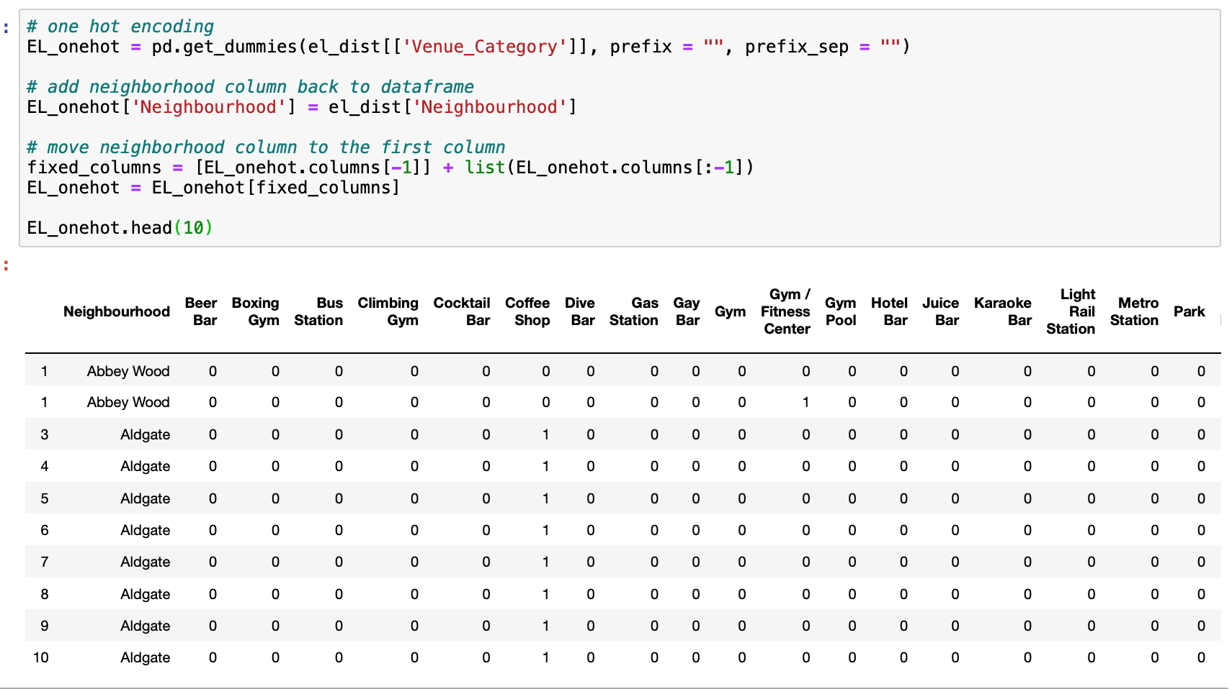
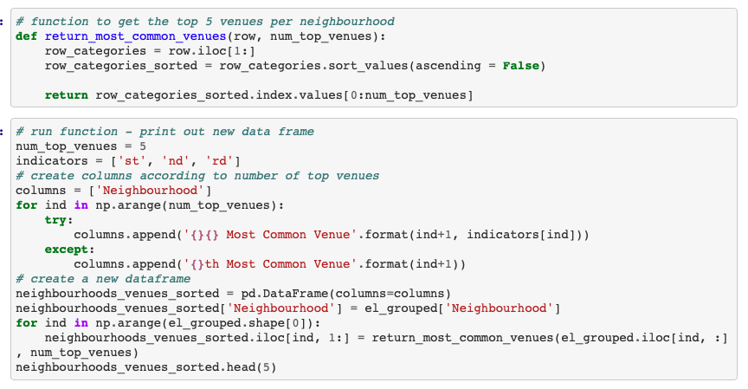
One-hot encoding: Output
Using this information, I could determine the top 5 most common venues per category. This data has been retrieved from Foursquare limiting bias for or against specifics venues or venue types. Imputing this data for the KMeans Clustering algorithm will help distinguish patterns and similarities between neighbourhoods, hopefully offering BrightMindsDS a range of suitable locations.

Slide 18
K-Means Clustering

Slide 19
K-Means Clustering What is it?
K-Means Clustering is an unsupervised machine learning algorithm. In contrast to traditional supervised machine learning algorithms, K-Means attempts to classify data without having first been trained with labelled data. Once the algorithm has been run and the groups are defined, any new data can be easily assigned to the most relevant group.
https://towardsdatascience.com/machine-learning-algorithms-part-9-k-means-example-in-python-f2ad05ed5203

Slide 20
K-Means Clustering How does it work?
Select
01
Select K (i.e. 2) random points as cluster centers called centroids
Assign
02
Assign each data point to the closest cluster by calculating its distance with respect to each centroid
Determine
03
Determine the new cluster center by computing the average of the assigned points
Repeat
04
Repeat steps 2 and 3 until none of the cluster assignments change

Slide 21
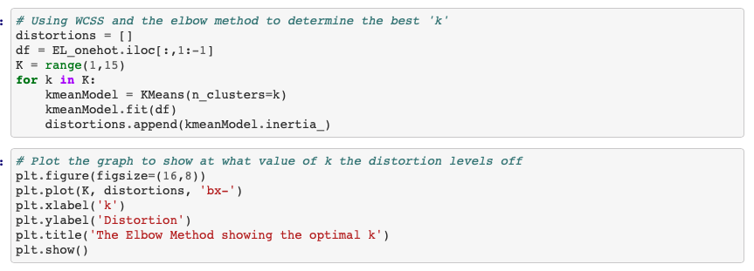
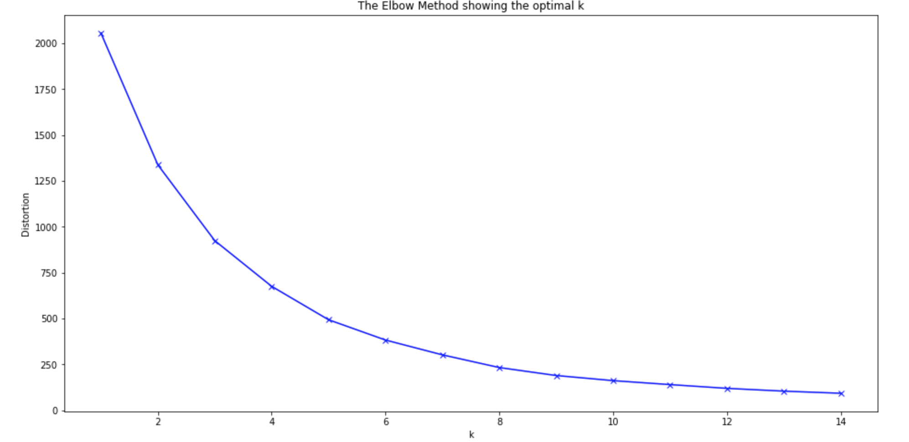
K-Means : Choosing the right number of clusters
The Elbow Method
Often, the data you’ll be working with will have multiple dimensions making it difficult to visualise. Consequently, the optimum number of clusters is hard to determine.
Fortunately, I can use a mathematical way to determine this. I can graph the relationship between the number of clusters and Within Cluster Sum of Squares (WCSS), then by selecting the number of clusters where the change in WCSS begins to level off (elbow method).
Based on these results, the ‘elbow’ can be seen when k=5. Therefore 5 clusters will be used

Slide 22
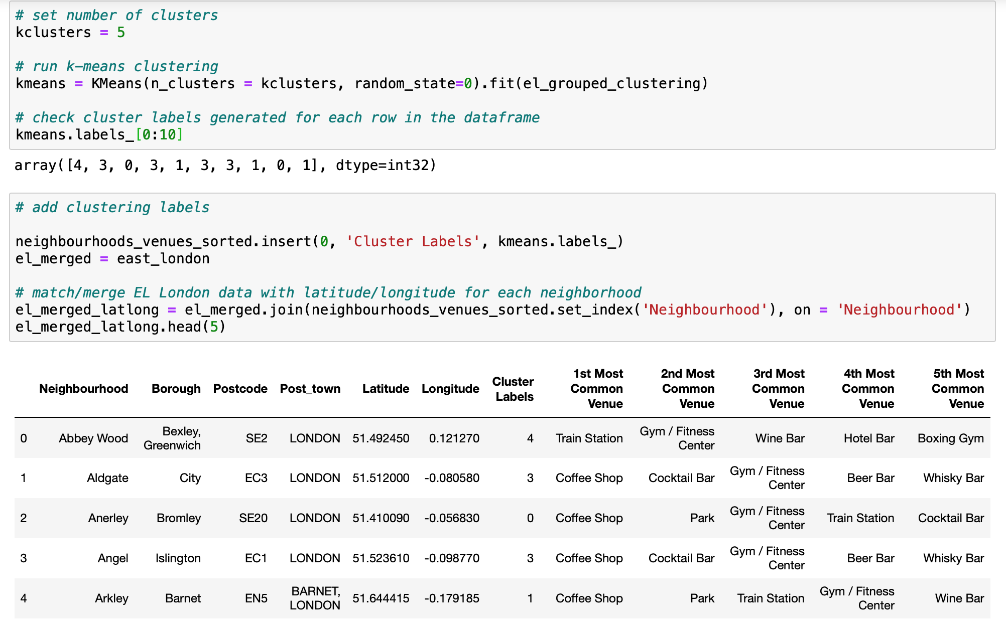
K-Means: The code
As can be seen within the data frame, each neighbourhood has been assigned a ‘cluster label’.
This shows what cluster that neighbourhood belongs too.

Slide 23
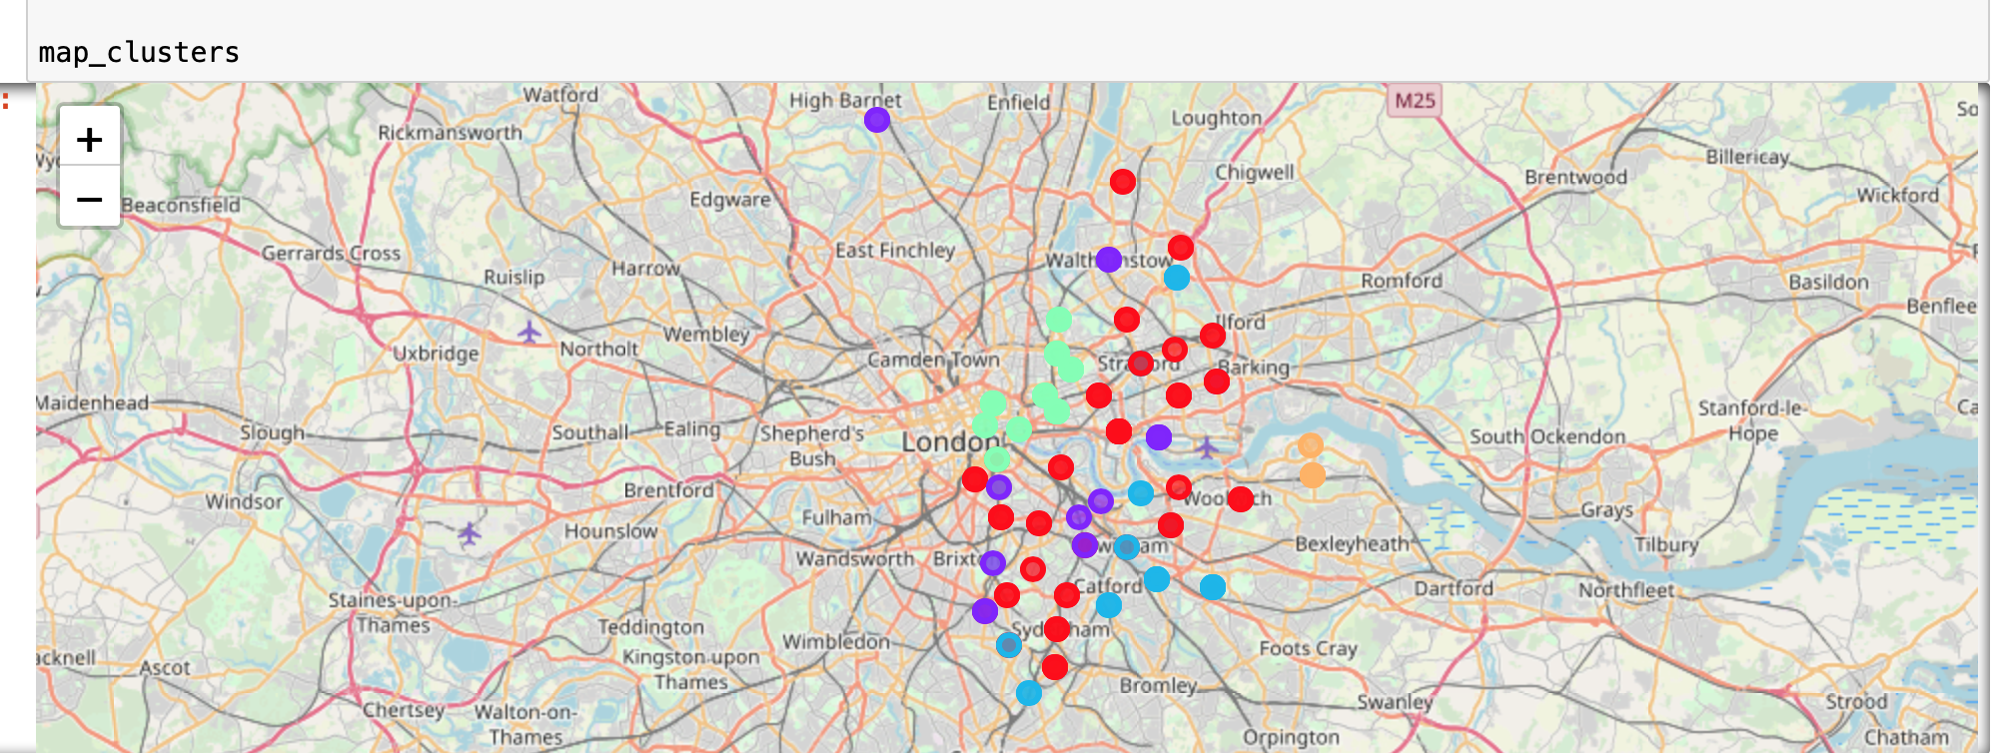
K-Means: Visualization
Using Folium, I can visualize these results.
The colour’s work as a key, we can clearly see 5 different groups.

Slide 24
Results and Discussion

Slide 25
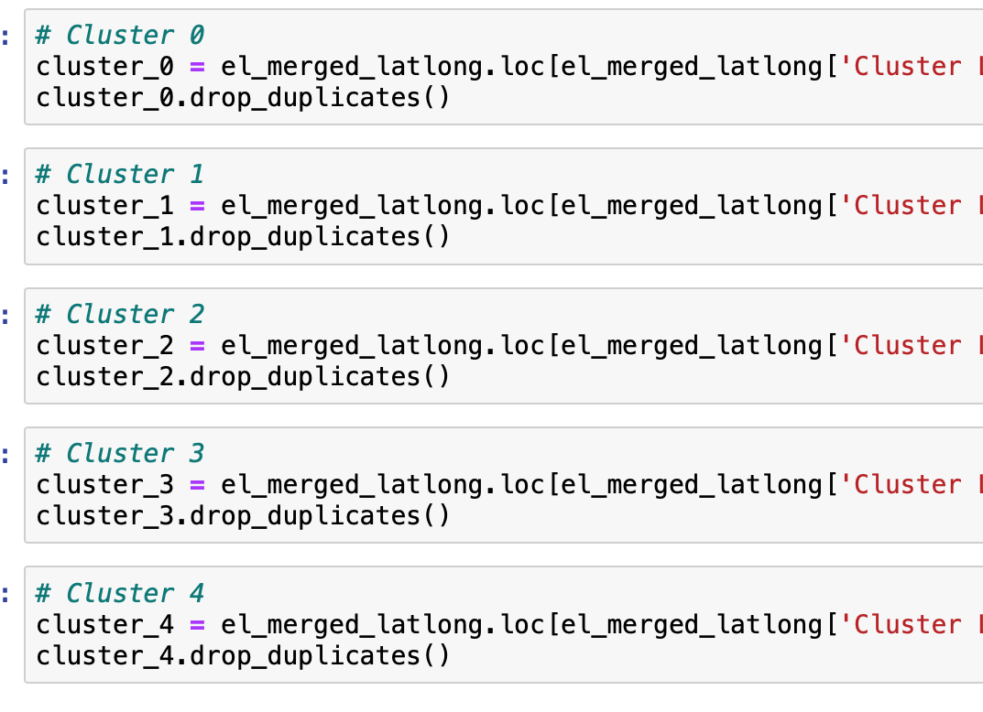
Breakdown of Each Cluster: The code
Looking at the individual clusters, the data sets are very similar, however it is the order and frequency that plays a big role in deciding which clusters are better suited to BrightMindsDS criteria. Which were as follows:
Can it be accessed via local transport?
Are there any gyms nearby?
Is there a nice park/open space near by?
Are there good coffee shops nearby for lunch?
Are there good bars/

Slide 26
Breakdown of Each Cluster: Analysis
Cluster 0 - Red
This cluster is one of the largest, made up of nearly 20 neighbourhoods. This offers BrightMindsDS a variety of locations spread out over the East of London. These neighbourhoods have coffee shops and parks listed as the most common venues. Offering many locations to socialise outside of work. This was a great positive for the company as stated in a recent article 'The beauty of a work café, is that it can be treated as both an area for relaxation and a place of engagement and innovation.' (1) This was one of the highest priorities for BrightMindsDS; generating innovation and offering a place to relax and take a break. The 3rd, 4th and 5th most common venues are made up of a variety of bars, gyms and most importantly transport stations. Bus, train, metro and Gas stations are common in these neighbourhoods. Travel in and around London will be essential for a rising company. Also to note, hotel bars and gay bars are listed too; suggesting inclusive cultures and possible venues for clients to stay.
Based on these factors Neighbourhoods in cluster 2 meet and go beyond BrightMindsDS expectations.
(1) https://www.blueprintinteriors.com/office-work-cafe/

Slide 27
Breakdown of Each Cluster: Analysis
Cluster 1 - Purple
Within these neighbourhoods, coffee shops and parks were the most popular venues. Suggesting good locations to socialise outside of work. This was a great positive for the company (explained in prev. slide). However there is very little mention of any local transportation. The realism of working in a big city like London is that employees will need to travel around the city to meet clients and/or commute. This means the neighbourhoods in cluster 1 will have to be ignored.

Slide 28
Breakdown of Each Cluster: Analysis
Cluster 2 – Light Blue
Looking at the data for cluster 2, I can see that:
Park is most common, good space to take a break, promote some outdoor team activities or working
Train station is also listed as one of the most common venues suggesting good rail and underground links which is great for commuters or when visiting clients.
Gym, boxing gym and gym pool mentioned, providing a different experience aside from a weights or cardio gym.
There are variety of bars on offer too.
Based on these factors Neighbourhoods in cluster 2 meet and go beyond BrightMindsDS expectations.

Slide 29
Breakdown of Each Cluster: Analysis
Cluster 3 – Green
Very similar to neighbourhoods in cluster 1; coffee shops and bars are very common; skate parks and fitness centres offer great facilities for BrightMindsDS employees to stay active. Promoting an active lifestyle and a good work-life balance. However, there is no mention of a bus or train station in the vicinity. As mentioned previously, city links and having the option to travel easily is essential to building a steady business. This requirement is a must so these neighbourhoods should be ignored.

Slide 30
Breakdown of Each Cluster: Analysis
Cluster 4 - Orange
These 2 neighbourhoods offer good transport links and quite an active location with a gym considered to be the 2nd most common venue. Again, seeing hotel bars suggests that clients can have a place to stay near the office which is a great feature. However, there is no data to suggest that a park or open space can be found within the radius of that location. This limits outdoor activities and could inhibit creativity, meaning neighbourhoods in cluster 4 should not be considered.

Slide 31
Conclusion
Looking at these results I would recommend any Neighbourhood classed in cluster 0 or cluster 2.
Both fulfil all requirements set out by BrightMindsDS; offering open spaces for employees to relax, recuperate and socialise as a team, have a variety of bars and gyms to escape to if work gets busy. As the company builds and secures more clients, more and more relationships will need to be made, stress may build up and long hours will need to be worked. Providing their employees with a nice office space in an ideal location is essential to improve employee morale and creativity. Making sure they are situated in an up and coming location will reflect well to potential clients and employees alike.
Further evaluation could have explored office space prices based on location, or reviews of the venues nearby. Foursquare provides so much data it has been very interesting to explore.

